Slide 1
PROJEC
CAPSTONE PROJECT
Presented By:
Student Name : Dheeraj Kothuri
College Name & Department : SRM IST RAMAPURAM & CSE-AIML

Slide 2
OUTLINE
Problem Statement
Technology used
Wow factor
End users
Result
Conclusion
Git-hub Link
Future scope

Slide 3
Problem Statement
Traditional encryption methods protect data but are easily detectable. Steganography allows secure communication by hiding secret messages inside images, making it difficult for hackers to detect hidden data. This project implements Least Significant Bit (LSB) Steganography with password-based decryption to enhance security.

Slide 4
Technology used
Programming Language: Python
Libraries Used:
OpenCV (cv2) - Image processing
NumPy - Pixel manipulation
Pillow (PIL) - Image handling
Tkinter - GUI for user interaction
Matplotlib - Image visualization
Hashlib - Secure password hashing

Slide 5
Wow factors
✅ Password-Based Decryption – Only authorized users can extract messages. ✅ JPG to PNG Auto-Conversion – Ensures lossless image format. ✅ Graphical User Interface (GUI) – Easy-to-use application with Tkinter. ✅ LSB Steganography – Invisible data hiding inside images. ✅ Secure Encryption (SHA-256) – Adds an extra security layer.

Slide 6
End users
🔹 Cybersecurity Experts – For secure data transmission. 🔹 Military & Intelligence Agencies – Covert communication. 🔹 Forensic Investigators – Hidden data recovery. 🔹 Digital Watermarking – Protecting copyrighted content. 🔹 General Users – Private communication.

Slide 7
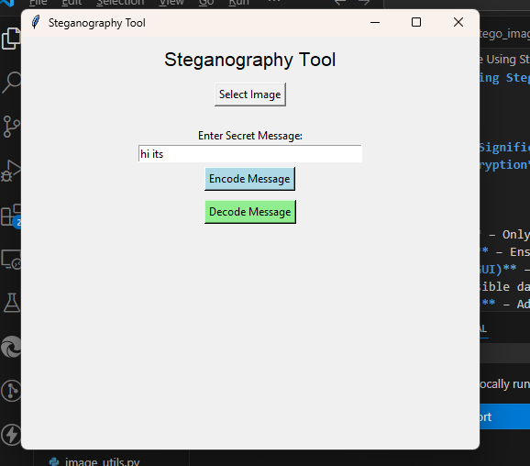
Results

Slide 8
Conclusion
This project successfully implements steganography using the Least Significant Bit (LSB) method while enhancing security with password-based decryption. By embedding data inside images, we ensure secure, undetectable communication while keeping the visual quality intact. The GUI interface makes the system easy to use for both technical and non-technical users.

Slide 9
GitHub Link
Github Link : https://github.com/Dheeraj-kothuri26/Aicte_Edunet_Cyber.git

Slide 10
Future scope(optional)
AES Encryption – Adding a stronger encryption layer before embedding. 🔹 Adaptive Steganography – Embedding data in less noticeable areas for higher security. 🔹 Audio & Video Steganography – Expanding beyond images. 🔹 AI-Based Steganalysis Resistance – Preventing detection by advanced tools.

Slide 11
THANK YOU

